Slide 1
Supervised Learning and k Nearest Neighbors

Slide 2
Supervised learning and classification
Given: dataset of records with known categories
Goal: using the “knowledge” in the dataset, classify a given instance
  predict the category of the given instance that is rationally consistent with the dataset

Slide 3
Classifiers
X1
X2
feature
values
X3
Y
…
Classifier
category
Xn
DB
collection of instances
with known categories

Slide 4
An example application
An emergency room in a hospital measures 17 variables (e.g., blood pressure, age, etc) of newly admitted patients.
A decision is needed: whether to put a new patient in an intensive-care unit.
Due to the high cost of ICU, those patients who may survive less than a month are given higher priority.
Problem: to predict high-risk patients and discriminate them from low-risk patients.

Slide 5
Another application
A credit card company receives thousands of applications for new cards. Each application contains information about an applicant,
  age
  Marital status
  annual salary
  outstanding debts
  credit rating
  etc.
Problem: to decide whether an application should approved, or to classify applications into two categories, approved and not approved.

Slide 6
The data and the goal
Data: A set of data records (also called examples, instances or cases) described by
  k attributes: A₁, A₂, … A_{k}.
  a class: Each example is labelled with a pre-defined class.
Goal: To learn a classification model from the data that can be used to predict the classes of new (future, or test) cases/instances.
Notes:
Induction is different from deduction and DBMS does not not support induction;
The result of induction is higher-level information or knowledge: general statements about data
There are many approaches. Refer to the lecture notes for CS3244 available at the Co-Op.
We focus on three approaches here, other examples:
Other approaches
Instance-based learning
other neural networks
Concept learning (Version space, Focus, Aq11, …)
Genetic algorithms
Reinforcement learning

Slide 7
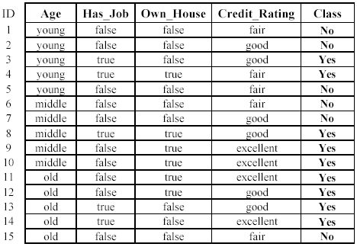
An example: data (loan application)
Approved or not

Slide 8
An example: the learning task
Learn a classification model from the data
Use the model to classify future loan applications into
  Yes (approved) and
  No (not approved)
What is the class for following case/instance?

Slide 9
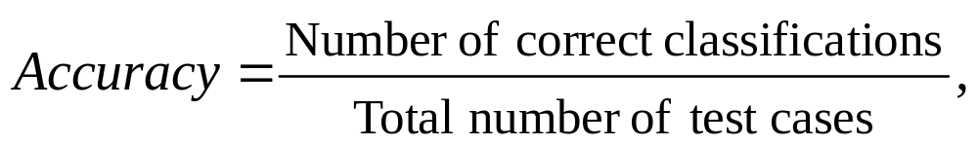
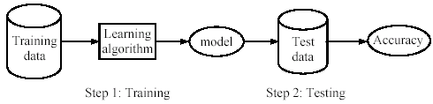
Supervised learning process: two steps
Learning (training): Learn a model using the training data
Testing: Test the model using unseen test data to assess the model accuracy

Slide 10
What do we mean by learning?
Given
  a data set D,
  a task T, and
  a performance measure M,
a computer system is said to learn from D to perform the task T if after learning the system’s performance on T improves as measured by M.
In other words, the learned model helps the system to perform T better as compared to no learning.

Slide 11
An example
Data: Loan application data
Task: Predict whether a loan should be approved or not.
Performance measure: accuracy.
No learning: classify all future applications (test data) to the majority class (i.e., Yes):
Accuracy = 9/15 = 60%.
We can do better than 60% with learning.

Slide 12
Fundamental assumption of learning
Assumption: The distribution of training examples is identical to the distribution of test examples (including future unseen examples).
In practice, this assumption is often violated to certain degree.
Strong violations will clearly result in poor classification accuracy.
To achieve good accuracy on the test data, training examples must be sufficiently representative of the test data.

Slide 13
Algorithms
K Nearest Neighbors (kNN)
Naïve-Bayes
Decision trees
Many others (support vector machines, neural networks, genetic algorithms, etc)

Slide 14
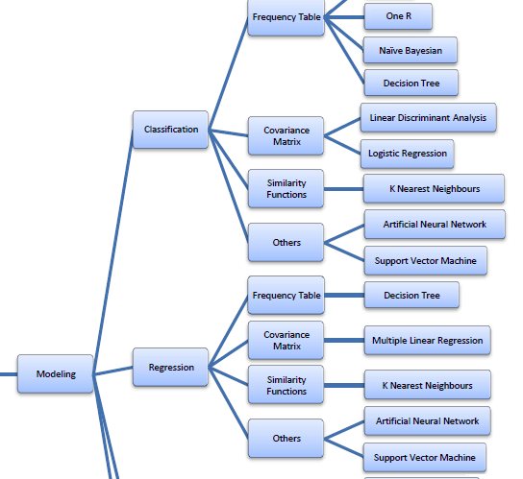

Slide 15
K - Nearest Neighbors
Assume you are given dataset instances (training examples).
For a given instance X, get the top k dataset instances that are “nearest” to X
  Select a reasonable distance measure
Inspect the category of these k instances, choose the category C that represent the most instances (majority vote).
Conclude that X belongs to category C

Slide 16
K - Nearest Neighbors
Input: D = {(x₁,c₁), …, (x_{N}, c_{N})}
x = (x₁, … x_{f}) new instance to be classified with f features.
KNN( x, D) :
FOR each labelled instance (x_{i},c_{i}) calculate d(x_{i},x)
Order d(x_{i},x) from lowest to highest, (i = 1,...,N) Select the K nearest instances to x: D
Assign to x the most frequent class in D

Slide 17
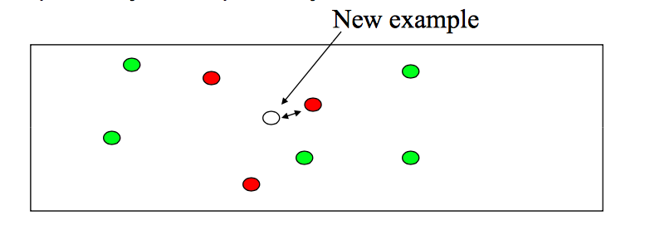
KNN Example
Given training dataset, with height and weight information labeled with gender (F/M).
Given a new example x, find its closest training example and predict the label / category based on its closest neighbor.
Notes:
K should be odd

Slide 18
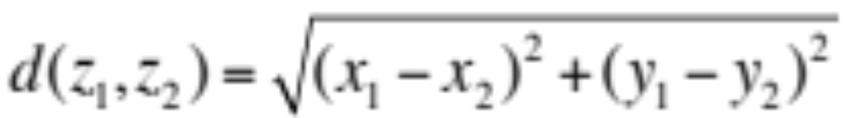
KNN Example (cont.)
How to measure distance??
Euclidian distance: squareroot of sum of squares of differences for two features:
Intuition: similar samples should be close to each other
  May not always apply
  (example: quota and actual sales)

Slide 19
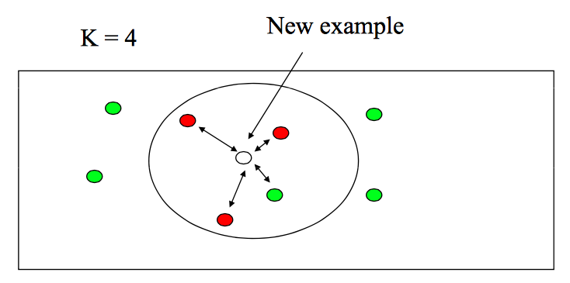
KNN Example
Find the k nearest neighbors and have them vote.
This is especially good if there is noise in the class labels.
Usually its best to choose odd K

Slide 20
Example 1
Determining decision on scholarship application based on the following features:
  Household income (annual income in millions of pesos)
  Number of siblings in family
  High school grade (on a GPA scale of 1.0 – 4.0)
Intuition (reflected on data set): award scholarships to high-performers and to those with financial need

Slide 21
Incomparable ranges
The Euclidian distance formula has the implicit assumption that the different dimensions are comparable
Features that span wider ranges affect the distance value more than features with limited ranges
Example:
  Suppose household income was instead indicated in thousands of pesos per month and that grades are given on a 70-100 scale.
  Suppose annual income is in dollars, and the other is based on age in years then income will have a much higher influence on the distance calculated.

Slide 22
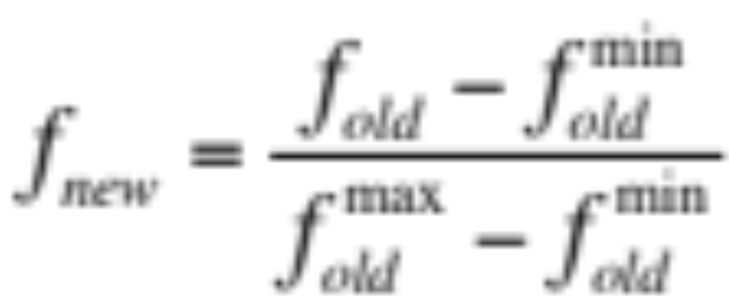
Incomparable ranges (Cont.)
One solution is to standardize ( or normalize) the training set features.
Approach 1: normalize features to be on the same scale.
  Linearly scale the range of each feature to be between [0,1]

Slide 23
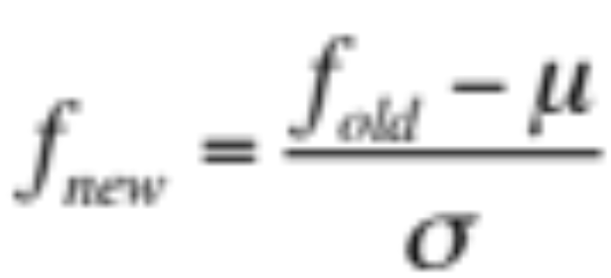
Incomparable ranges (Cont.)
Approach 2: normalize features to be on the same scale.
  Linearly scale to 0 mean and variance 1.
  For each feature x = (x₁, x₂, … x_{n}) compute the mean (μ) and the standard deviation (σ) for each feature.
  This is called Mahalanobis distance (link). Assumes features are independent of each other.

Slide 24
Non-numeric data
Feature values are not always numbers
Example
  Boolean values: Yes or no, presence or absence of an attribute
  Categories: Colors, educational attainment, gender
How do these values factor into the computation of distance?

Slide 25
Dealing with non-numeric data
Boolean values => convert to 0 or 1
  Applies to yes-no/presence-absence attributes
Non-binary characterizations
  Assign arbitrary numbers but be careful about distances; e.g., color: red, yellow, blue => 1,2,3 … bad approach, why?
  Given that we want to represent red, yellow, and blue, then represent as a 3-bit vector.
  This way distance between blue and yellow vs yellow and red is the same.

Slide 26
Preprocessing your dataset
Dataset may need to be preprocessed to ensure more reliable data mining results
Conversion of non-numeric data to numeric data
Calibration of numeric data to reduce effects of disparate
ranges
  Particularly when using the Euclidean distance metric

Slide 27

Evaluating classification methods
Predictive accuracy
Efficiency
  time to construct the model
  time to use the model
Robustness: handling noise and missing values
Scalability: efficiency in disk-resident databases
Interpretability:
  understandable and insight provided by the model
Compactness of the model: size of the tree, or the number of rules.

Slide 28
Evaluation methods
Holdout set: The available data set D is divided into two disjoint subsets,
  the training set D_{train} (for learning a model)
  the test set D_{test} (for testing the model)
Important: training set should not be used in testing and the test set should not be used in learning.
  Unseen test set provides a unbiased estimate of accuracy.
This method is mainly used when the data set D is large.

Slide 29
Evaluation methods (cont…)
n-fold cross-validation: The available data is partitioned into n equal-size disjoint subsets.
Use each subset as the test set and combine the rest n-1 subsets as the training set to learn a classifier.
The procedure is run n times, which give n accuracies.
The final estimated accuracy of learning is the average of the n accuracies.
10-fold and 5-fold cross-validations are commonly used.
This method is used when the available data is not large.

Slide 30
Evaluation methods (cont…)
Validation set: the available data is divided into three subsets,
  a training set,
  a validation set and
  a test set.
A validation set is used frequently for estimating parameters in learning algorithms.
In such cases, the values that give the best accuracy on the validation set are used as the final parameter values.
Cross-validation can be used for parameter estimating as well.

Slide 31
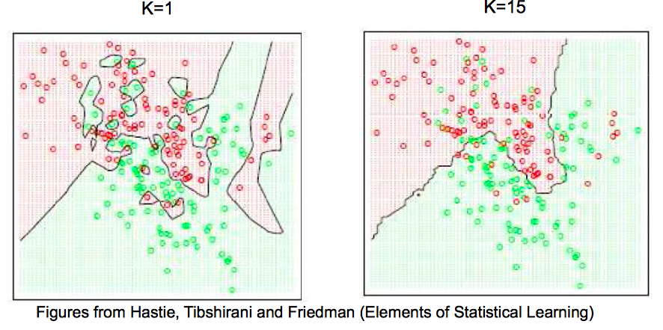
Effect of k
If k is too small, its sensitive to noise points
Larger k produces smoother boundary effect and can reduce impact of class label noise.

Slide 32
Effect of k
As a rule of thumb, K is chosen to be equal to the square root of the number of instances.
  Popularized by the "Pattern Classification" book by Duda et al.
Cross-validation is a well established technique that can be used to obtain estimates of model parameters that are unknown. It can be used to determine k.
Divide the data sample into a number of v folds.
For a fixed value of k, we apply the KNN model to make predictions on the vth segment and evaluate the error.
This process is then applied to all possible choices of v.
At the end of the v folds (cycles), the computed errors are averaged to yield a measure of the stability of the model.
The above steps are then repeated for various k and the value achieving the lowest error is then selected as the optimal value for k.

Slide 33
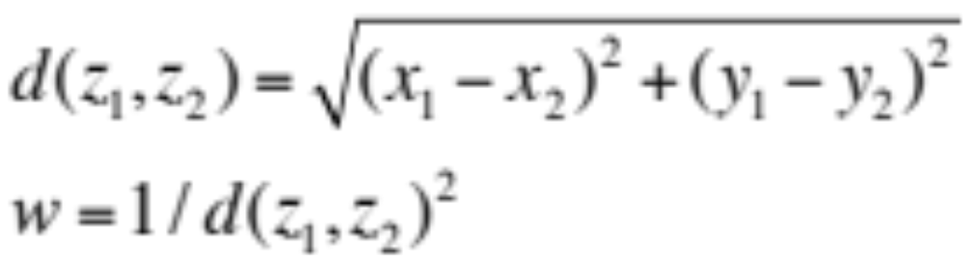
k-NN variations
Weighted evaluation of nearest neighbors
  Plain majority may unfairly skew decision
  Revise algorithm so that closer neighbors have greater “vote weight”
  i.e. let the closest points among the K nearest neighbors have more say in affecting the outcome
  This can be achieved by introducing a set of weights W, one for each nearest neighbor, defined by the relative closeness of each neighbor with respect to the new sample.

Slide 34
Other distance measures
City-block distance (Manhattan dist)
  Add absolute value of differences
Cosine similarity
  Measure angle formed by the two samples (with the origin)
Jaccard distance
  Determine percentage of exact matches between the samples (not including unavailable data)
Others

Slide 35
k-NN Time Complexity
Suppose there are n instances and f features in the dataset
Each distance computation involves scanning through each feature value, hence:
  O(f) to compute distance to one example.
  O(nf) to compute distance to all other examples and classify one new sample.
  Plus, O(nk) time to find k closest examples.
  Total time: O(nk + nf)
K-NN is very expensive for a large number of samples.
  But we need a large number of samples for kNN to work well!!.

Slide 36
K-NN curse of dimensionality
Consider the problem of classifying text based on authorship.
May decide to extract features from text by representing a document using n-grams… thus generating thousands of features.
Some features may be irrelevant…
“Intrinsic” dimensionality may be smaller than the number of features
Notes:
Stopped here !

Slide 37
Curse of dimensionality
Datasets typically highly dimensional
  Vision : 10⁴ pixels, texts: 10⁶ features
True dimensionality often much lower
  True dimensionality refers to features that actually affect classification.
Dealing with high dimensionality
  Use domain knowledge to reduce dimensions
  Reduce the dimensionality of the data (more common approach)

Slide 38
Choosing sets of features
Score each feature
Forward/Backward elimination
  Choose the feature with the highest/lowest score
  Re-score other features
  Repeat
If you have lots of features (like in text)
  Just select top K scored features

